Slide 1



X
Manual Testing, API Testing, Automation Testing
Virtual Internship Experience – Rakamin (Batch September 2023)
Presented by
Syidiq Susanto

Slide 2


Syidiq Susanto
About Me
I am a fresh graduate from the information system department at Amikom Yogyakarta University. Have an interest in technology, especially in the field of Development and Quality Assurance. I bring a strong critic logical thinking and problem solving skills and the ability to work effectively in teams and communicate well with others

Slide 3

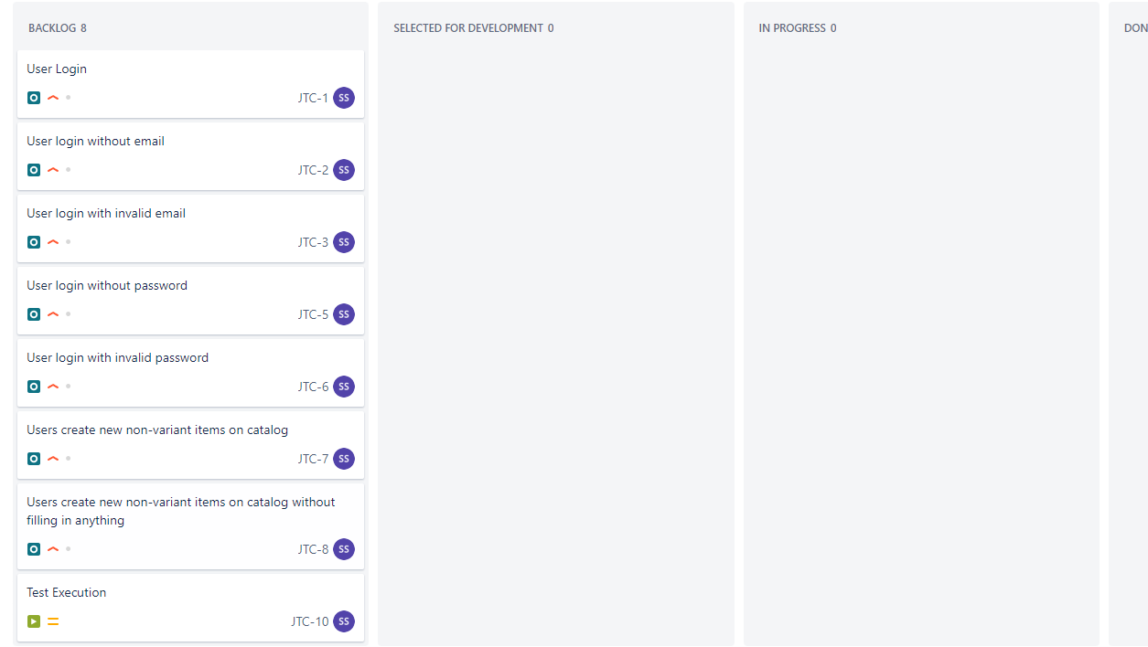
Case Study
Manual Testing Website Jubelio at Jira
Test Case

Slide 4
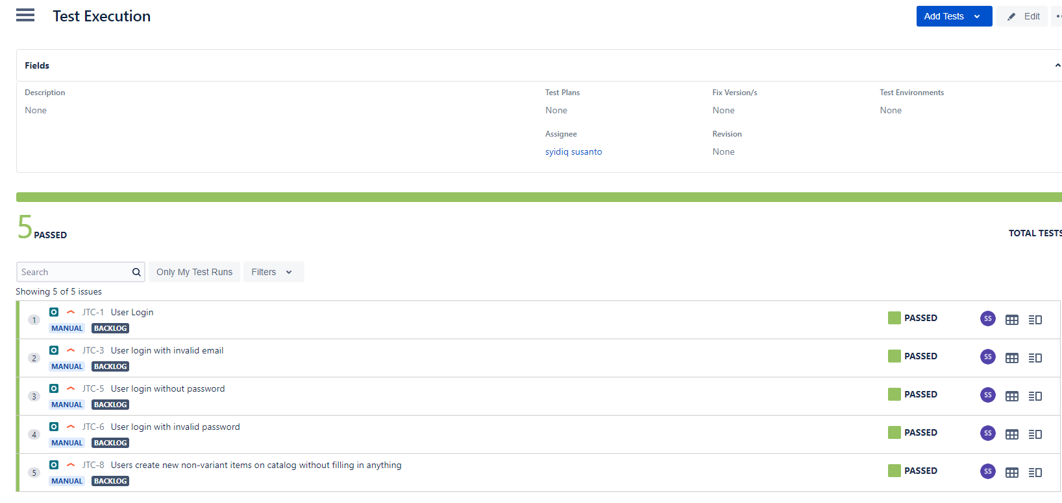
Result
Manual Testing Website Jubelio at Jira using xray

Slide 5
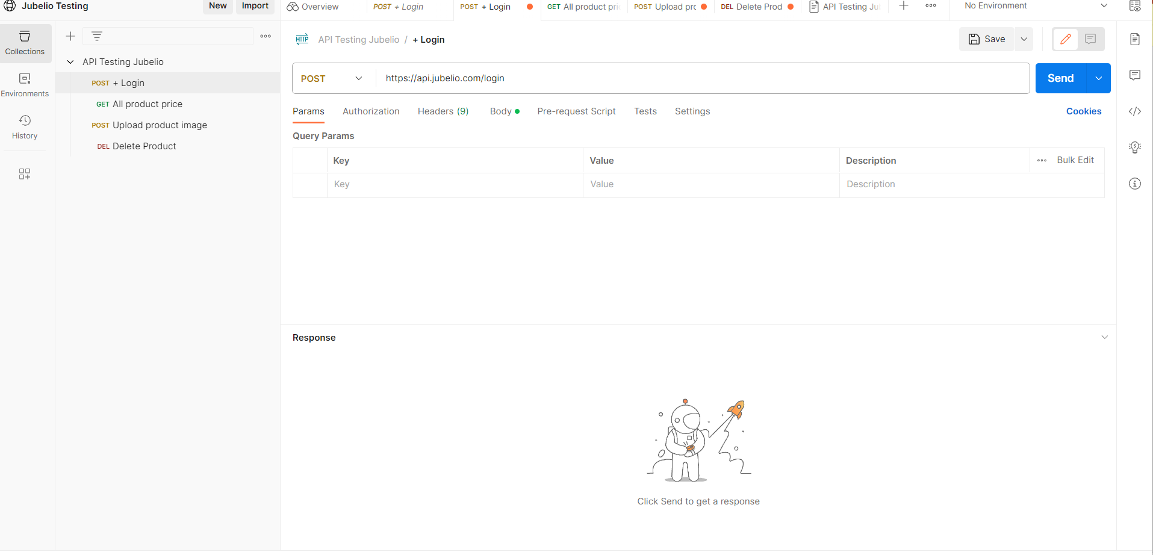
Case Study
API Testing Jubelio using Postman
Test Case

Slide 6
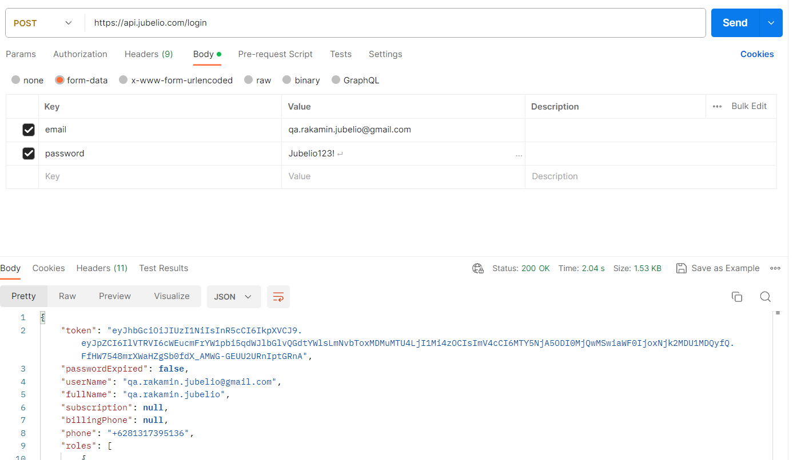
Result
API Testing Jubelio using Postman

Slide 7
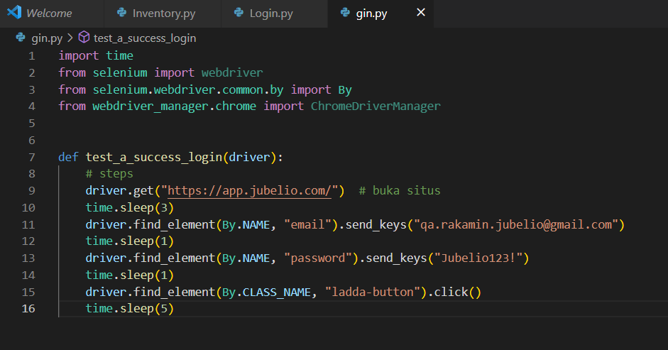
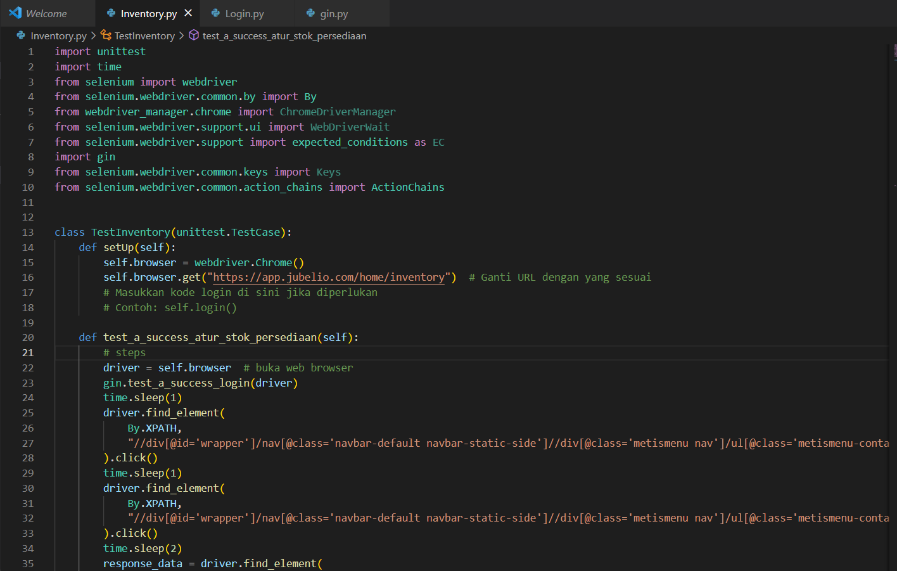
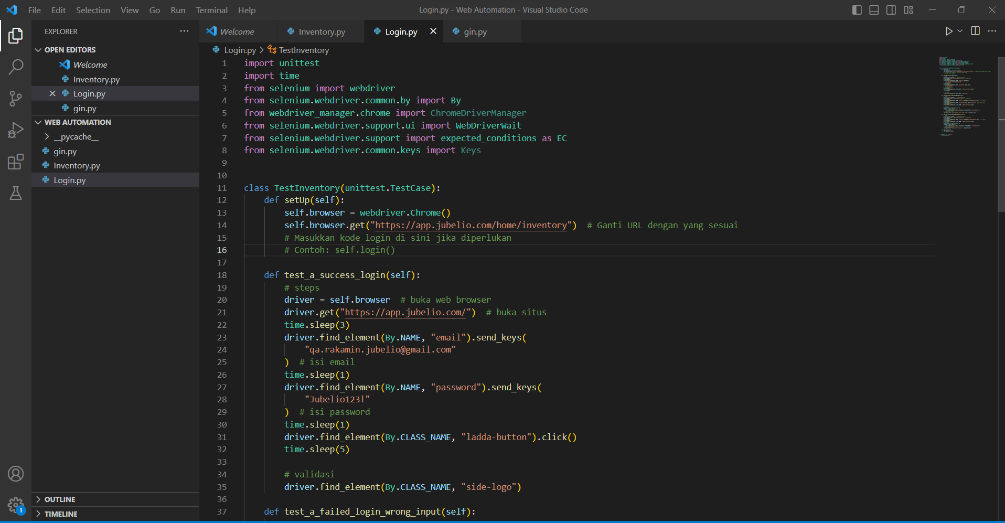
Case Study
Automation Testing Jubelio using Selenium Webdriver Java
Base login
Inventory source code
Login flow source code

Slide 8
Github Repository
link GitHub : https://github.com/syidiqss

Slide 9
Video Presentation
link video : https://drive.google.com/file/d/1kBD3LkmMAqGMn8epdrTbf3UYmloIDXjH/view?usp=sharing

Slide 10
Thank You
X

